Slide 1

The Past, Present and Future of Mobile Apps
Raegan Hart - ha13137034@student.citybathcoll.ac.uk
Notes:
Good Morning my name is Raegan Hart, I am a mobile app developer and I would like to take roughly 15minutes of your time to talk about the past, present and future of mobile apps.

Slide 2
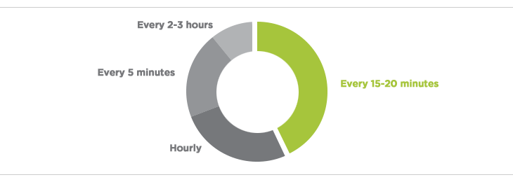
How often do we use out mobile phones?
Notes:
Technology has firmly entrenched itself in our lives, from the moment we wake up in the morning to the last thing we do before we sleep, technology is playing a monumental role in the way we behave as individuals. Just to put things into perspective for you, a study carried out by O2 last year found that the average smartphone user tends to spend approximately 2 hours a day using their device. That’s nearly one whole month a year spent solely on our phones!
With this being the state of play, the focus of today’s presentation is to reflect on mobile technology in terms of the past and also highlight how it will change during the present and foreseeable future. Let’s get started…

Slide 3
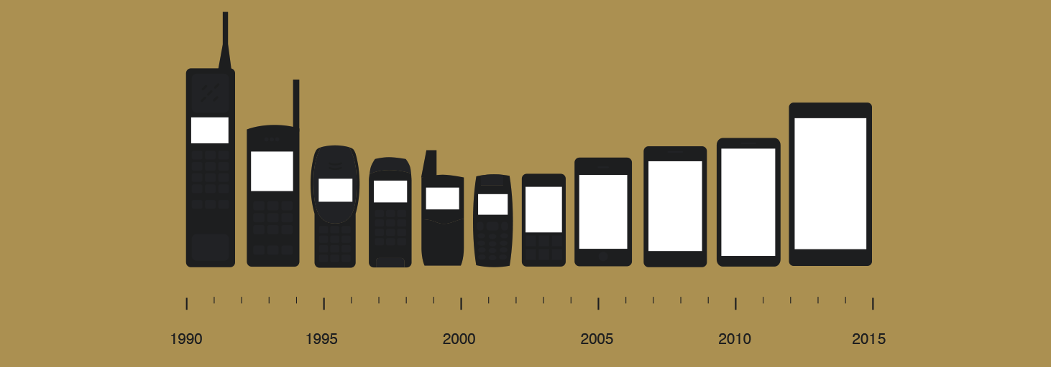
The history of the smart phone
Notes:
The Past – looking back into mobile technology within the past does not involve trawling through the history books, as mobile technology is still only relatively new. The first smart phone was the Simon Personal Communicator built in 1994 by IBM but the first smartphone that we class today didn’t enter the mainstream until 2007 when the iPhone by Apple was released.

Slide 4

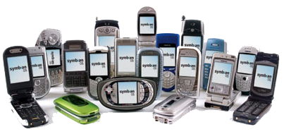
Notes:
The Symbian OS is the operating system developed and sold by Symbian Ltd. The first version of Symbian was released in 1997, as EPOC32. The OSis was used primarily by Nokia with its S60 user interface and by Sony Ericsson.

Slide 5
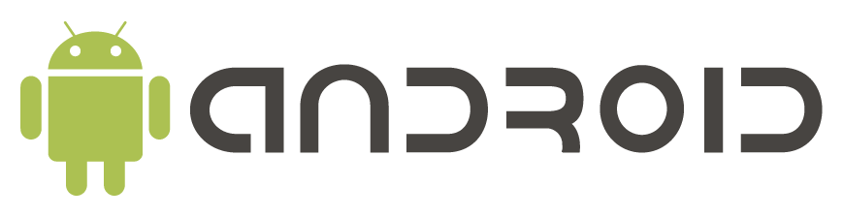
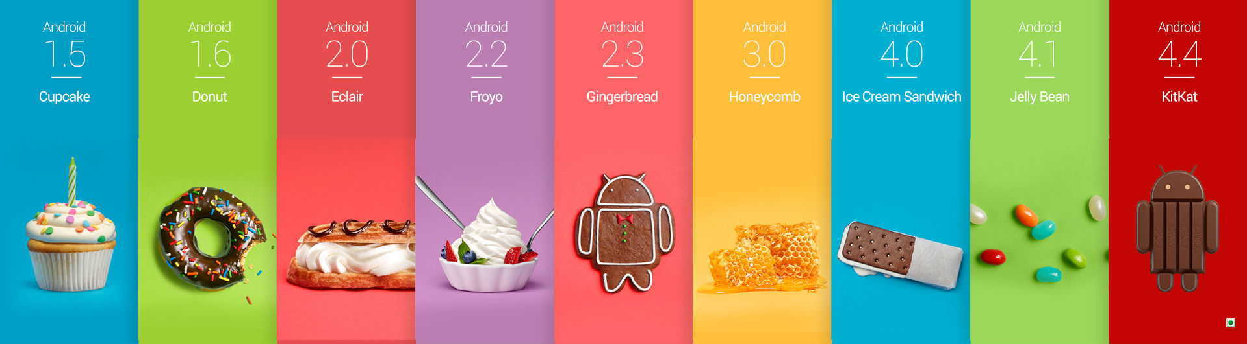
Notes:
In 2008, Google released Android 1.0 which first released on the HTC Dream which provided such features as web browsing, email server access, instant messaging and media player functionality.
- Android 1.5 Cupcake was Androids first operating system that was top of the smart phone world in 2008.
Androids 1.6 Donut allowed users improved functionality searching the web and watching videos online.
Android 2.0 Eclair allowed homepage customisation to its users such as the ability to arrange apps and widgets around the screen.
Android 2.2 Froyo allowed the user the function of voice input typing messages.
Android 2.3 Gingerbread displayed sensors which improved functionality for apps which used tilting functions.
Android 3.0 Honeycomb added tablet support due to the rise of tablets.
Android 4.0 Ice Cream included a refined design, 1080p HD camera support and photo editor.
Android 4.1 Jelly Bean improved Bluetooth support with smart devices such as other smartphones and tablets alongside including ‘Google Now’.
Android 4.4 KitKat featured improved design and performance.
Lastly and not displayed is Android 5.0 Lollipop which added support for bigger and smaller screens such as smart televisions and tablets.

Slide 6
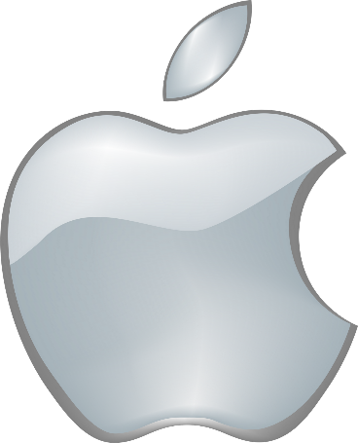
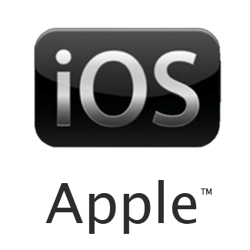
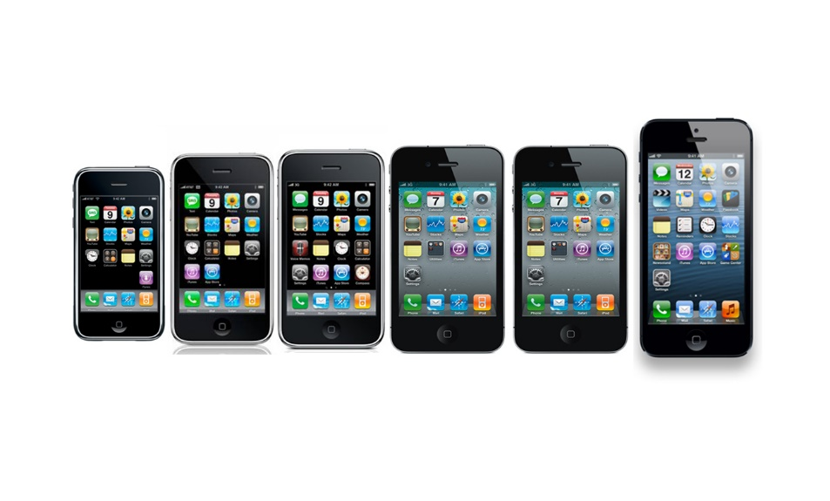
Notes:
Apple released the iPhone 1 in 2007, this demonstrated multi-touch screen functionality, iOS versions 1 to 3, as well as HTML email, web browsing and YouTube accessibility. iPhone revolutionised the Mobile Technology industry by providing a mobile media centre through its technology and features.

Slide 7
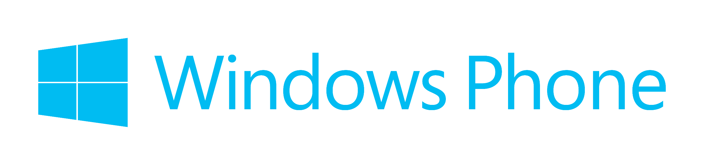
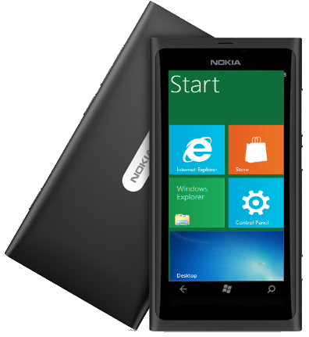
Notes:
Windows phone OS was introduced in 2010 with its first version being 7, this was mainly used in Nokia smartphones. Utilising the Metro UI this displays live tiles that make up the start screen. Each tile is linked to a corresponding app such as contacts, media, web pages, etc all of which can be customized.

Slide 8
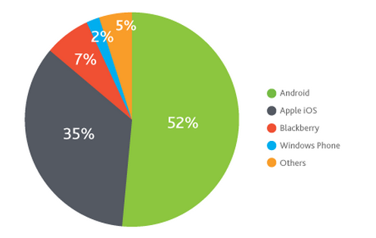
The leading operating systems
Notes:
In present day Android and Apple iOS are the leading competitors in the mobile operating system world, with Blackberry and others such as Symbian declining dramatically over the last 5years.

Slide 9
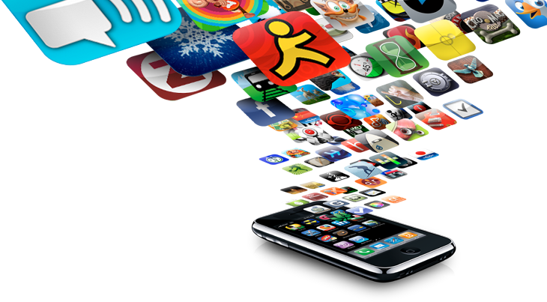
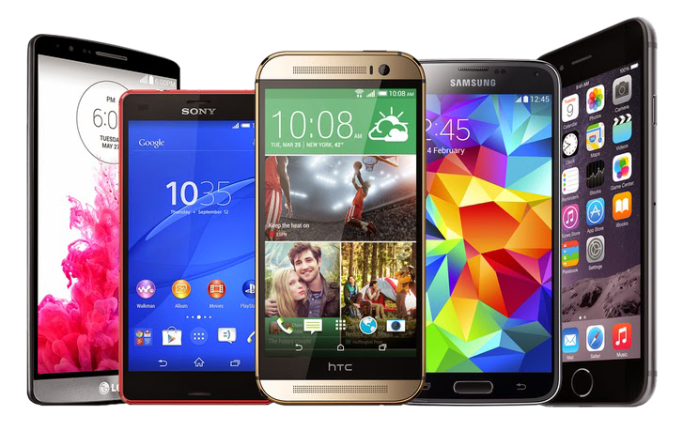
Smart phones in the present day
Notes:
Over the last 7 years we have seen mobile technology, especially smartphones, emerge as a realistic alternative to traditional forms of accessing information such as web browsing to eventually becoming the “go to device” for many customers. The fact that many businesses starting up now begin with having a mobile optimised website speaks volumes for how mobile technology has shaped the business world around us.
Added to this is the popularity of apps such as Facebook, Whatsapp, Twitter and Skype to name just a few that have allowed mobile applications to flourish amongst socially savvy customers.
Fast-forwarding to the here and now highlights just how quickly mobile technology has become part of our daily lives. For example, the mobile device has replaced many household devices and can now be considered our complete entertainment and lifestyle device.

Slide 10
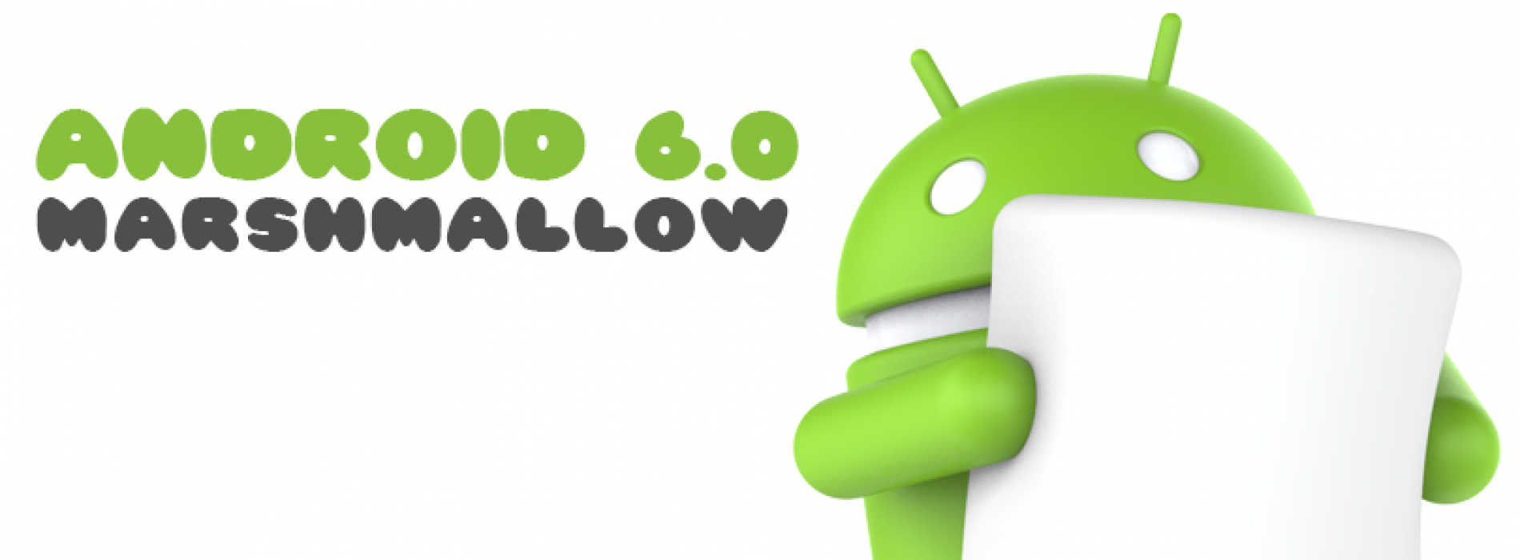
Android today
Notes:
Released in October 2015 here is 10 things that Marshmallow couldn’t do in lollipop:
1. Get Google Now on tap
2. Make the most of USB Type-C
3. Manage permissions more easily
4. Use a fingerprint as security
5. Manage volumes more intuitively
6. Let your device Doze
7. Get the real web inside your apps
8. Select text more accurately
9. Share to your most-used apps
10. Back up everything in your apps

Slide 11
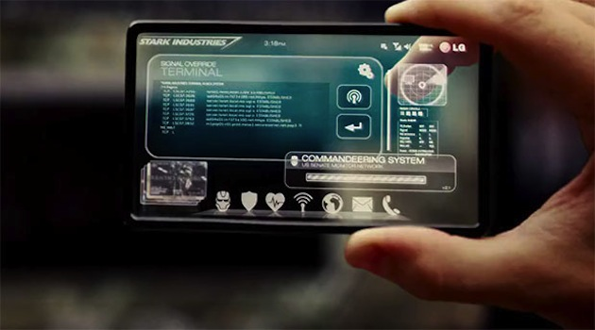
The future of mobile phones
Notes:
It can be difficult to predict the future with regards to technology with any certainty as the market evolves and adapts so quickly. However, one thing that is clear to see is that mobile technology is the next frontier for technology. With so much potential to unlock in terms of features, services, untapped developing markets and consumer preferences, mobile technology is the leading industry on the planet.
In 1 years time VR technology with such gadgets as Google Cardboard, Oculus Rift and Microsoft HoloLens making its way into mainstream society.

Slide 12
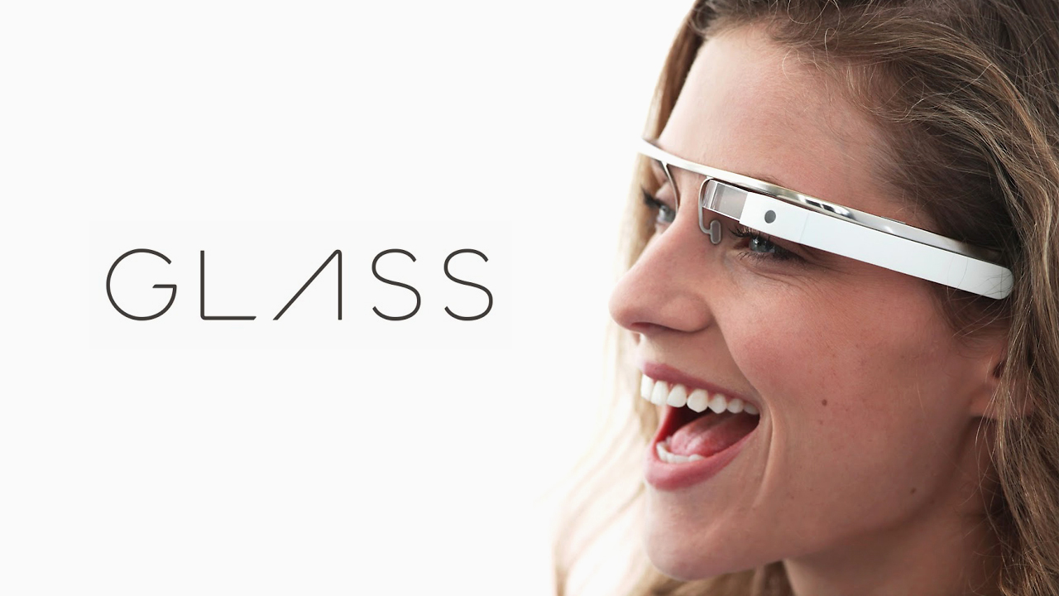
What’s coming next?
Notes:
Wearable technology will be the future of the mobile lifespan, producing such gadgets as the ‘Google Glass’ in 2020 which will replace the mobile phone completely. Other wearables have been suggested such as mini speakers built into your ears, microphones under teeth fillings, contact lens to display data and even scarier have a mobile device built under your skin.
Unfortunately that is the end of the presentation, I hope you have enjoyed what has been spoken about and you can take away some facts you didn’t know about the past, present and future of mobile technology.
Thank you for your time.

Slide 13
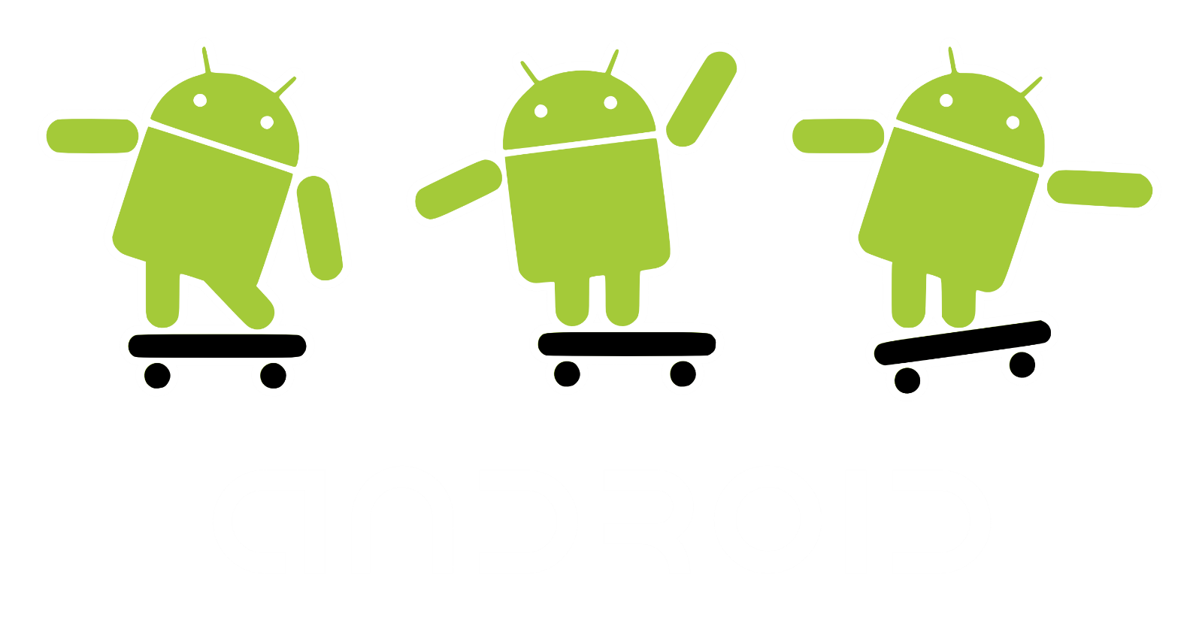
Any questions?
Notes:
Any Questions?

Slide 14

References
https://www.android.com/intl/en_uk/
https://www.microsoft.com/en-us/windows/phones
http://www.apple.com/uk/iphone/
http://www.pcworld.com/article/2042071/the-end-of-symbian-nokia-ships-last-handset-with-the-mobile-os.html
https://www.google.co.uk/intl/en/glass/start/
http://www.o2.co.uk/
http://www.eazi-apps-business.co.uk/mobile-technology-past-present-future/
All pictures were found on Google Images.

